Slide 1

Algorithms: Efficiency, Analysis, and Order
CMPS323: Lecture-1
Read Chapter 1

Slide 2

Analysis of Algorithms: Time Complexity Analysis
Complexity Analysis
how an algorithm is efficient
So, we can compare algorithms using theoretical and standard methods
Analyzing efficiency in terms of time
independent of the computer, programming language, programmer, complex details of the algorithm such as incrementing of loop indices, setting of pointers
not actual number of CPU cycles → depends on particular computer
not count of every instruction executed → depends on programming language and the programmer

Slide 3
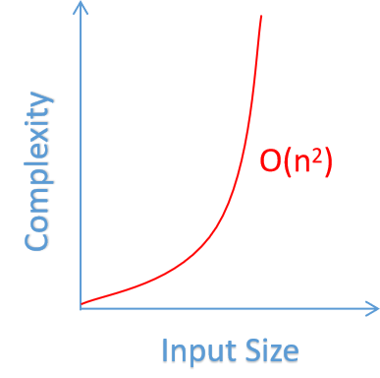
Time Complexity Analysis (cont.)
Standard technique for analyzing algorithms
compare the numbers of comparisons done by algorithms for various values of n
(n is the number of items in the array)
Running time
increases with the size of the input
proportional to how many times some basic operation (comparison instruction) is done
We analyze the algorithm’s efficiency by
determining the number of times some basic operation is done

Slide 4
Time Complexity Analysis (cont.)
For many algorithms, it is easy to find a measure of the input size n
Sequential Search, Binary Search, and Add Array Members
n is the number of items in the array
Matrix Multiplication
n is the number of rows and columns
Basic operation is some instruction such that
total work done by the algorithm is proportional to the number of times this instruction is done
no strict rule for choosing the basic operation
a matter of judgment and experience
Example: (Binary or Sequential Search) comparison instruction of x with an item S

Slide 5
Time Complexity Analysis (cont.)
In some cases, the number of times it is done
depends not only on the input size, but also on the input’s values
Example: Sequential Search
if x is the first item in the array, the basic operation is done once
if x is not in the array, it is done n times
When the basic operation is always done the same number of times for every instance
T(n) is called the every-case time complexity of the algorithm
determination of T(n) is called an every-case time complexity analysis
Example:
Add Array Members
basic operation is always done the same number of times for every instance of size n

Slide 6
Time Complexity Analysis (cont.)
Analysis of Algorithm 1.2
Every-Case Time Complexity (Add Array Members)
Basic operation: the addition of an item in the array to sum
Input size: n, the number of items in the array
T(n) = n
Notes:
1.2:
Regardless of the values of the numbers in the array, there are n passes through the for loop. Therefore, the basic operation is always done n times and
1.3:
We must determine how many passes there are through the for-j loop. For a given n there are always n − 1 passes through the for-i loop. In the first pass through the for-i loop, there are n − 1 passes through the for-j loop, in the second pass there are n − 2 passes through the for-j loop, in the third pass there are n −3 passes through the for-j loop, ... , and in the last pass there is one pass through the for-j loop.
Therefore, the total number of passes through the for-j loop is given by

Slide 7
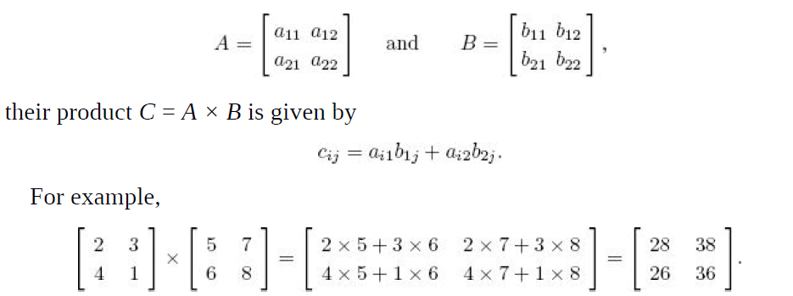
Time Complexity Analysis (cont.)
Analysis of Algorithm 1.4
Every-Case Time Complexity (Matrix Multiplication)
Basic operation: multiplication instruction in the
innermost for loop
Input size: n, the number of rows and columns
For many algorithms, the basic operation is not done the same number of times
These algorithms do not have an every-case time complexity
W(n) is the maximum number of times the algorithm will ever do its basic operation
W(n) is called the worst-case time complexity of the algorithm
T(n) = n * n * n = n³
Notes:
The only instruction in the innermost for loop is the one that does a multiplication and an addition. It is not hard to see that the algorithm can be
implemented in such a way that fewer additions are done than multiplications. Therefore, we will consider only the multiplication instruction to be the basic operation.
There are always n passes through the for-i loop, in each pass there are always n passes through the for-j loop, and in each pass through the for-j loop there are always n passes through the for-k loop. Because the basic operation is inside the for-k loop,

Slide 8
Time Complexity Analysis (cont.)
Analysis of Algorithm 1.1
Worst-Case Time Complexity (Sequential Search)
Basic operation: the comparison of an item in the array with x
Input size: n, the number of items in the array
In some cases, we are interested in how algorithm performs on the average
A(n) is defined as the average of the number of times the algorithm does the basic operation for an input size of n
A(n) is called the average-case time complexity of the algorithm
It is usually harder to analyze the average case than it is to analyze the worst case
W(n) = n
Notes:
1.1
The basic operation is done at most n times, which is the case if x is the last item in the array or if x is not in the array. Therefore,

Slide 9
Time Complexity Analysis (cont.)
B(n) is defined as the minimum number of times the algorithm will ever do its basic operation for an input size of n
B(n) is called the best-case time complexity of the algorithm
Analysis of Algorithm 1.1
Best-Case Time Complexity (Sequential Search)
Basic operation: the comparison of an item in the array with x
Input size: n, the number of items in the array
B(n) = 1
Notes:
A final type of time complexity analysis is the determination of the smallest number of times the basic operation is done.
1.1
Because n ≥ 1, there must be at least one pass through the loop, If x = S[1], there will be one pass through the loop regardless of the size of n.

Slide 10

Time Complexity Analysis (cont.)
For algorithms that do not have every-case time complexities
we do worst-case and average-case analyses more often than best-case analyses
An average-case analysis is valuable
how much time the algorithm would take when used on many different inputs
Examples
Sorting algorithm is used repeatedly to sort all possible inputs. Relatively slow sort can occasionally be tolerated if, on the average, the sorting time is good.
Average-case analysis would not suffice in a system that monitored a nuclear power plant. Worst-case analysis would be more useful because it would give us an upper bound on the time taken by the algorithm
For both the applications above, a best-case analysis would be of little value
Analysis of memory complexity can similarly be carried out

Slide 11
Which Complexity Analysis Technique to Select?
Depends on the specific requirements and characteristics of the application
For safety-critical systems where performance guarantees are essential, worst-case analysis is often preferred
In more general or diverse applications, average-case analysis can provide a more realistic view of expected performance
Best-case analysis is applicable in situations where you want to understand the most favorable performance of an algorithm
Nuclear Power Plant: Worst Case
Data Encryption Algorithms: Worst Case
Web Search Engine Ranking: Average Case
Sorting Algorithms: Average Case
Image Processing for Social Media Applications: Average Case
Real-Time Video Processing for Autonomous Vehicles: Best-case analysis helps identify the upper limit of the system's performance when all conditions are optimal. It might be useful for benchmarking purposes, understanding the potential capabilities of the system under ideal circumstances.

Slide 12
Quick Check
Algorithm analysis measures the efficiency of an algorithm as the ---------becomes large
Input size
-----------is defined as the number of times the algorithm does the basic operation for an instance of size n
T(n)
W(n) is defined as the minimum number of times the algorithm will ever do its basic operation for an input size of n (True or False)
False
A(n) is called average-case time complexity of the algorithm (True or False)
True

Slide 13
Applying the Theory of Algorithm Analysis
One must sometimes be aware of the time it takes to execute the basic operation, and:
Overhead instructions
such as initialization instructions before a loop
the number of times these instructions execute does not increase with input size
Control instructions
such as incrementing an index to control a loop
the number of times these instructions execute increases with input size
Basic operation, overhead instructions, and control instructions
properties of an algorithm and the implementation of the algorithm

Slide 14
Applying the Theory (cont.)
Example
2 algorithms for the same problem with
T(n) = n for Algorithm-1 and T(n) = n² for Algorithm-2
Algorithm-1 appears more efficient
Assume that the time it takes to execute the overhead instructions is negligible
Imagine a scenario where a computer requires 1,000 times more time to execute basic operations and control instructions in Algorithm-1 compared to the time it takes for the same processing in Algorithm-2
if t is the time required to process the basic operation once in Algorithm-2
1,000 t is the time required to process the basic operation once in Algorithm-1
1,000t for Algorithm-1
t for Algorithm-2

Slide 15
Applying the Theory (cont.)
The times it takes the computer to process an instance of size n
n × 1,000t for Algorithm-1 [ T(n) = n ]
n² × t for Algorithm-2 [ T(n) = n² ]
We must solve the inequality to determine when Algorithm-1 is more efficient
Dividing both sides by nt yields
If the application never had an input size larger than 1,000
Algorithm-2 should be implemented although its T(n) is n²
n² * t > n * 1000t
n > 1000

Slide 16
Order
As seen, an algorithm with a time complexity of n is more efficient than
one with a time complexity of n² for sufficiently large values of n
regardless of how long it takes to process the basic operations in the two algorithms
Similarly
If there are two algorithms for the same problem
T(n) = 100n for Algorithm-1
T(n) = 0.01n² for Algorithm-2
Algorithm-1 is more efficient if:
Dividing both sides by 0.01n yields:
If it takes longer to process the basic operation in Algorithm-1 than Algorithm-2
there is simply some larger value of n at which Algorithm-1 becomes more efficient
0.01 n² > 100n
n > 10,000

Slide 17
Order
Linear-time algorithms
Algorithms with time complexities such as n and 100n
because their time complexities are linear in the input size n
Quadratic-time algorithms
Algorithms with time complexities such as n² or 0.01 n²
because their time complexities are quadratic in the input size n
“Any linear-time algorithm is eventually more efficient than any quadratic-time algorithm”

Slide 18
Quadratic Functions
2.a. Pure quadratic functions
contain no linear term such as 5n² and 5n² + 100
2.b. Complete quadratic functions
contain a linear term such as 0.1n² + n + 100
Eventually, the quadratic term dominates this function
Although the function is not a pure quadratic function
we can classify it with the pure quadratic functions
n | 0.1n² | 0.1n² + n + 100
10 | 10 | 120
20 | 40 | 160
50 | 250 | 400
100 | 1,000 | 1,200
1,000 | 100,000 | 101,100

Slide 19
Introduction to Order
We should always be able to throw away low-order terms
when classifying complexity functions
For example: We can classify 0.1n³ + 10n² + 5n + 25 with pure cubic functions
The set of all complexity functions that can be classified with pure quadratic functions
called Θ(n²) (theta in Greek)
we say that the functions are order of n²
Examples
g(n) = 5n² + 100n +20 ∈ θ(n²) g(n) is order of n²

Slide 20
Introduction to Order (cont.)
Quadratic-time algorithm or a Θ(n²) algorithm
when an algorithm’s time complexity is in Θ(n²)
Qubic-time algorithm or a Θ(n³) algorithm
when an algorithm’s time complexity is in Θ(n³)
Most common complexity categories (from best to worst category)
Θ(1) Θ(lg n) Θ(n) Θ(n lg n) Θ(n²) Θ(n³) Θ(a^{n}) Θ(n!)

Slide 21
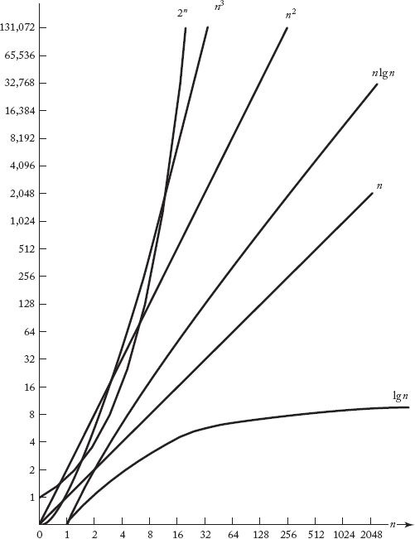
Introduction to Order (cont.)
Execution times for algorithms
Growth rates of complexity functions

Slide 22
Introduction to Order (cont.)
Possibly surprising result
Even the quadratic-time algorithm takes 31.7 years
to process an instance with an input size of 1 billion
Θ(n lg n) algorithm takes only 29.9 seconds to process such an instance
An algorithm has to be Θ(n lg n) or better
to process extremely large instances in tolerable amounts of time
This is not to say that algorithms with higher-order categories are not useful
Algorithms with quadratic, cubic, and even higher-order time complexities can
handle the actual instances that arise in many applications
Matrix multiplication (cubic)
Bubble sort (quadratic)
…
Notes:
There is more information in knowing a time complexity exactly than in simply knowing its order.
recall the hypothetical algorithms, that have time complexities of 100n and 0.01n².
If it takes the same amount of time to process the basic operations and execute the overhead instructions in both algorithms, then the quadratic-time algorithm is more efficient for instances smaller than 10,000. If the application never requires instances larger than this, the quadratic-time algorithm should be implemented.
If we knew only that the time complexities were in Θ(n) and Θ(n2), respectively, we would not know this. The coefficients in this example are extreme, and in practice they are often less extreme. Furthermore, there are times when it is quite difficult to determine the time complexities exactly. Therefore, we are sometimes content to determine only the order.

Slide 23
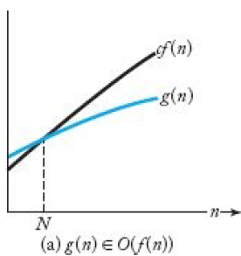
A Rigorous Introduction to Order (Upper Bound)
Definition
For a given complexity function f(n), O(f(n)) is the set of complexity functions g(n) for which there exists some positive real constant c and some nonnegative integer N such that for all n ≥ N
g(n) ≤ c * f(n)
f(n)
g(n)
Upper bound
Although g(n) starts out above cf(n) in that figure, eventually it falls beneath cf(n) and stays there
n² + 10n is initially above 2n², for n ≥ 10
We can take c = 2 and N = 10 in the
definition of “big O” to conclude that
n² + 10 n ∈ O(n²)

Slide 24
A Rigorous Introduction to Order (cont.)
“Big O” describes the asymptotic behavior of a function
because they are concerned only with eventual behavior
“Big O” puts an asymptotic upper bound on a function
Examples
We show that 5n² ∈ O(n²). Because, for n ≥ 0,
we can take c = 5 and N = 0 to obtain our desired result
5 n² ≤ 5 n²

Slide 25
A Rigorous Introduction to Order (cont.)
Note: there is no unique c nor unique N that must be found to show that one function is “big O” of another
Recall n² + 10n ∈ O(n²) using c = 2 and N = 10. Alternatively, we could show it as follows
3. We show that n² + 10n ∈ O(n²). Because, for n ≥ 1,
we can take c = 11 and N = 1 to obtain our result
4. We show that n² ∈ O(n² + 10n). Because, for n ≥ 0,
we can take c = 1 and N = 0 to obtain our result
Note: The function inside “big O” does not have to be one of the simple functions.
It can be any complexity function. However, we take it to be a simple function
n² + 10n ≤ n² + 10n² = 11n²
n² ≤ 1 * (n² + 10n)

Slide 26
A Rigorous Introduction to Order (cont.)
5. We show that n ∈ O(n²). Because, for n ≥ 1,
we can take c = 1 and N = 1 to obtain our result
Note: A complexity function need not have a quadratic term to be in O(n²)
It need only eventually lie beneath some pure quadratic function on a graph
Therefore, any logarithmic or linear complexity function is in O(n²)
Similarly, any logarithmic, linear, or quadratic complexity function is in O(n³), and so on
n ≤ 1 * n²
Some exemplary members of the set O(n²)

Slide 27
A Rigorous Introduction to Order (Lower Bound) Ω (omega)
Definition
For a given complexity function f(n), Ω(f(n)) is the set of complexity
functions g(n) for which there exists some positive real constant c
and some nonnegative integer N such that, for all n ≥ N,
If g(n) ∈ Ω(f(n)), we say that g(n) is omega of f(n).
Examples
We show that 5n² ∈ Ω(n²). Because, for n ≥ 0,
we can take c = 1 and N = 0 to obtain our result
g(n) ≥ c * f(n)
5n² ≥ 1 * n²

Slide 28
A Rigorous Introduction to Order (cont.)
2. We show that n² + 10n ∈ Ω(n²). Because, for n ≥ 0,
n² + 10n ≥ n²
we can take c = 1 and N = 0 to obtain our result

Slide 29
A Rigorous Introduction to Order (cont.)
If a function is in Ω(n²), then eventually the function lies above some pure quadratic function on a graph
eventually it is at least as bad as a pure quadratic function
4. We show that n³ ∈ Ω(n²). Because, if n ≥ 1,
we can take c = 1 and N = 1 to obtain our result
Note that the function need not be a quadratic function
n³ ≥ 1 * n²
Some exemplary members of the set Ω(n²)

Slide 30
A Rigorous Introduction to Order (Tight Bound) theta (Θ)
Definition
For a given complexity function f(n)
This means that Θ(f(n)) is the set of complexity functions g(n)
for which there exists some positive real constants c and d and
some nonnegative integer N such that, for all n ≥ N
If g(n) ∈ Θ(f(n)), we say that g(n) is order of f(n)
Θ ( f(n) ) = O( f(n) ) ∩ Ω( f (n) )
c * f(n) ≤ g(n) ≤ d * f(n)

Slide 31
A Rigorous Introduction to Order (cont.)
Examples
Function 5n + 7 is not in Ω(n²), and the function
4n³ + 3n² is not in O(n²)
Therefore, neither of these functions is in Θ(n²)
Intuitively, this seems correct
O(n²)
Ω(n²)
Θ(n²) = O(n²) ∩ Ω(n²)

Slide 32
Quick Check
Algorithms with time complexities such as n and 100n are called ----- algorithms
Linear time
Algorithms with time complexities such as n^2 are called quadratic-time algorithms (True or False)
True
Any quadratic-time algorithm is eventually more efficient than any linear-time algorithm (True or False)
False
Function such as 5n^2 and 5n^2+100 are called ----- functions
Pure quadratic

